Slide 1


MADE PROJECT
Data Science Job Salary Analysis
DATE: JANUARY 2024
Prepared by: Arpita Halder
Matriculation Number: 22974970

Slide 2
Agenda
Introduction
Motivation
Data Sources
Analysis
Conclusion

Slide 3

Introduction
Welcome to my presentation: 'Decoding Data Science Salaries.' In today's age of big data and rapid technological progress, data science plays a pivotal role in driving innovation, efficiency, and strategic decision-making across industries. With organizations leaning heavily on data-driven insights, the demand for skilled data scientists has soared, creating a competitive job market where salary structures are key. Join me as we delve into a comprehensive exploration, uncovering patterns, trends, and geographical variations that define compensation packages in this dynamic field.

Slide 4



Motivation
Empowering Careers: Unveiling the Significance of Data Science Job Salary Analysis for Informed and Strategic Decision-Making.
Informed Career Decisions:
Understand earning potential in data science.
Align career expectations with market standards.
Make informed decisions for a rewarding career.
Negotiation Power:
Equip yourself with salary insights for negotiations.
Knowledge of industry standards enhances bargaining.
Maximize earning potential through strategic negotiation.
Market Trends and Career Planning:
Identify trends for informed career planning.
Recognize industries and regions with higher compensation.
Strategically align skills for both passion and financial success.

Slide 5

Data Sources:
Data Source 1:
Data URL: https://www.kaggle.com/datasets/thedevastator/jobs-dataset-from-glassdoor/ Data Type: CSV format Total datasize: 741 Dataset Year: 2017-2018
About: This dataset encapsulates job postings sourced from Glassdoor.com, spanning the period of 2017-2018 and focusing on positions within the United States. The dataset is enriched with a diverse set of features providing comprehensive insights into each job listing.
Data Source 2:
Data URl: https://www.kaggle.com/datasets/arnabchaki/data-science-salaries-2023 Data Type: CSV format Total datasize: 3755 Dataset Year:2020-2023
About: The analysis was conducted utilizing a dataset that encompasses pertinent information regarding Data Scientists from 2020-2023.

Slide 6
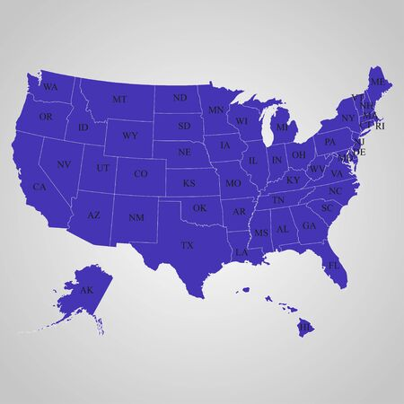
Analysis
Let us start with……

Slide 7
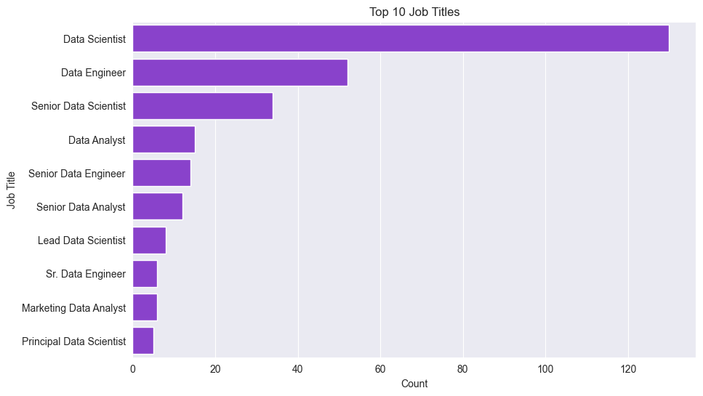
1. What are the Top 10 Job titles in United-States?
Notes:
Inference 1: The analysis reveals a substantial prevalence of job listings for Data Scientist and Data Engineer roles, suggesting a robust demand for these professions in the United States. This observation implies a noteworthy abundance of opportunities in comparison to other data-related jobs, emphasizing the significance of these roles in the American job market.

Slide 8
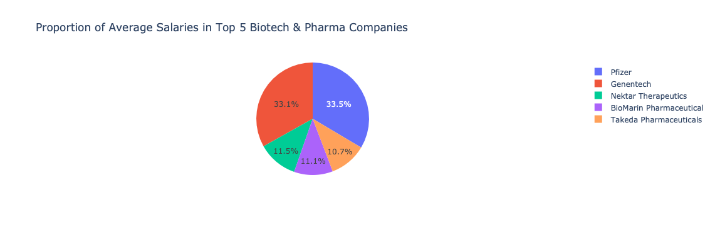
2. What are the different types of ownership and their counts in the United States?
Private : 402 and Public: 193
3. What are the top five industries with the most job listings in the United States?
Biotech & Pharmaceuticals
Which are those top 5 Biotech & Pharmaceuticals companies?
4. How is the revenue distributed among the companies?
Major corporations, predominantly in the 10+ billion (USD) bracket, feature prominently among companies with disclosed revenue figures, while a diverse mix is evident with a significant representation in the mid-range, spanning from 100 million to 2 billion (USD)
Notes:
Inference 2: The fact that most companies are privately owned suggests there are plenty of opportunities in the private sector. For entrepreneurs, it's worth considering ventures in data technology, which is booming and gaining importance in the American business scene.
Inference 3 : Based on the analysis, the Biotech & Pharmaceuticals industry emerges as the sector with the highest number of job listings in data science. Notably, within this industry, companies such as Genentech and Pfizer stand out for offering comparatively higher salaries, reflecting a distinct salary trend among top players in the field.
Inference 4: Among companies with disclosed revenue figures, a notable proportion belongs to the 10+ billion (USD) bracket, underscoring the presence of major corporations in the dataset. Additionally, there is a significant representation in the mid-range, with a considerable number of companies reporting revenues between 100 million to 2 billion (USD), highlighting a diverse mix of companies operating at various scales.

Slide 9
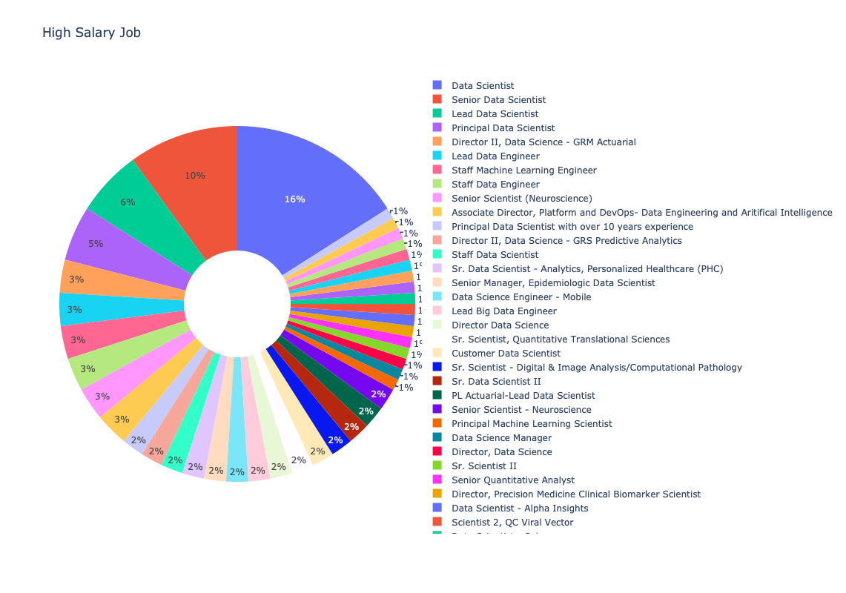
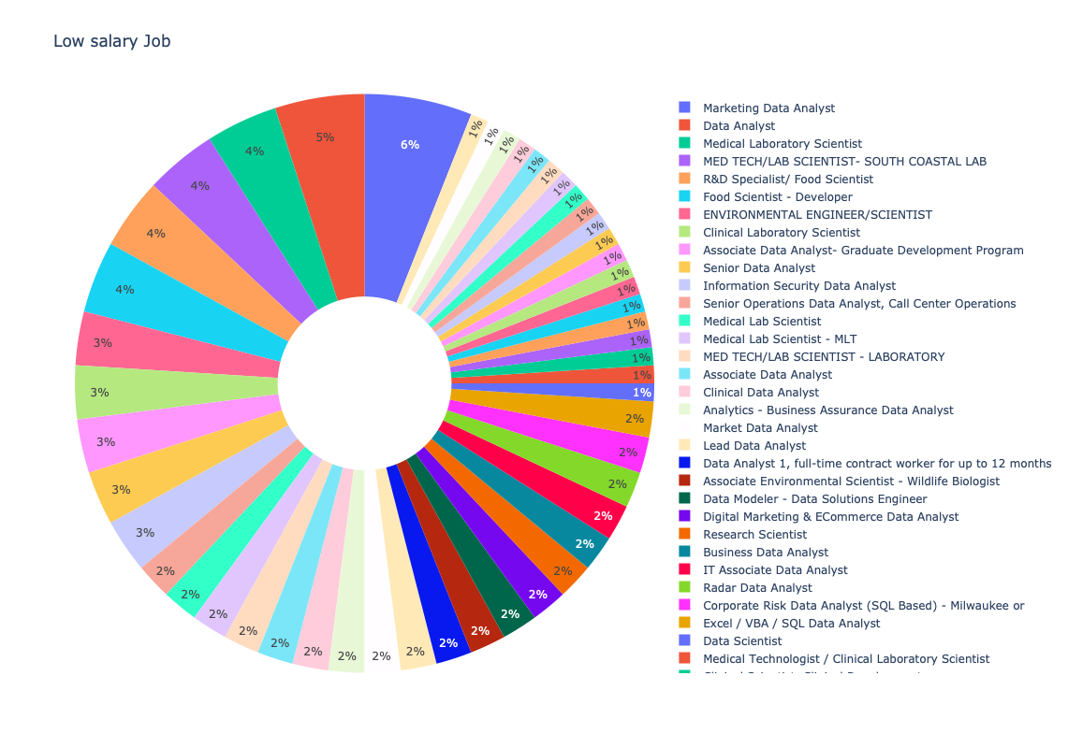
5. What are the high and low salary job titles in the field of data?
Notes:
Inference 5:
High Salary Job
Based on the analysis, it is evident that within the data field, the highest salaries are earned by Data Scientists, constituting 16% of the roles, followed by Senior Data Scientists at 10%. Lead Data Scientists and Lead Data Engineers secure the next positions with 6% and 3%, respectively. The hierarchy indicates that Data Scientists generally command the highest salaries, trailed by Data Engineers and Data Managers in descending order.
Low Salary Job
The analysis reveals a disparity in salaries among Data Analyst roles, with Marketing Data Analysts and Senior Data Analysts earning considerably more than Research Scientists, Staff Scientists and Junior Analysts. This highlights distinct salary variations within the Data Analyst domain, emphasizing the impact of specialization and experience on compensation levels.

Slide 10
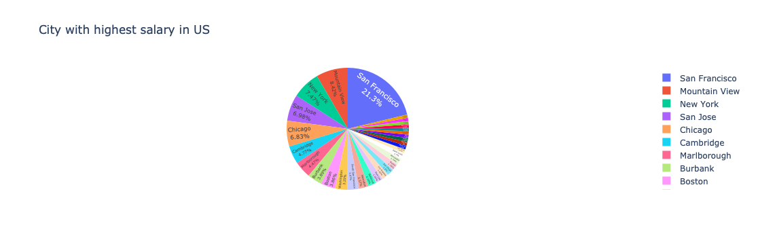
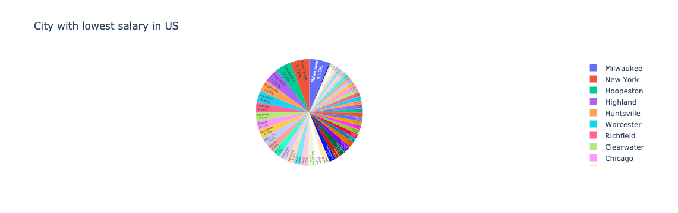
6. Which city in the United States have the highest and lowest salary in the field of data?
Notes:
Inference 6: The analysis indicates that San Francisco contributes approximately 21% of the top 100 highest-paying cities, showcasing its prominence in lucrative employment opportunities. Surprisingly, cities like New York, Chicago, and Boston, while featuring prominently among the highest-paying cities, constituting about 7% of the highest-paying cities,is also in city with low salary revealing regional disparities in salary distributions.

Slide 11
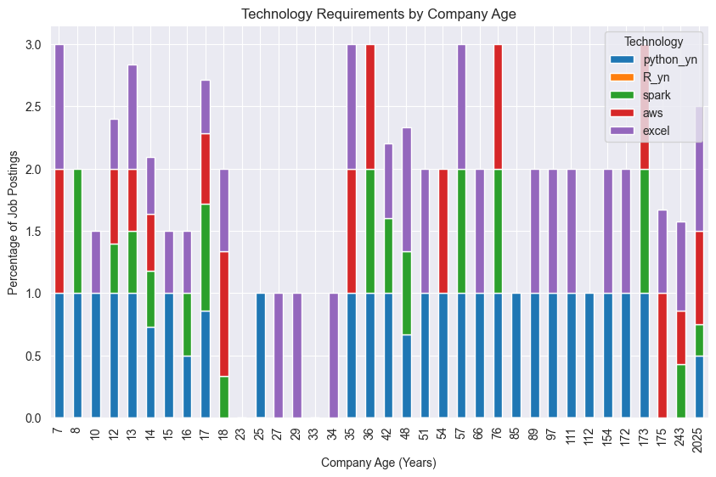

7. What is the technology requirements by high salary company age?
Notes:
Inference 7: Python emerges as the predominant technology adopted universally across companies, spanning a wide age range from 7 to 173 years. Excel exhibits pervasive usage across companies irrespective of their age. While Spark and AWS find application in select companies, notably absent is the utilization of R language. Consequently, mastering Python and Excel is deemed essential for proficiency in the field.

Slide 12
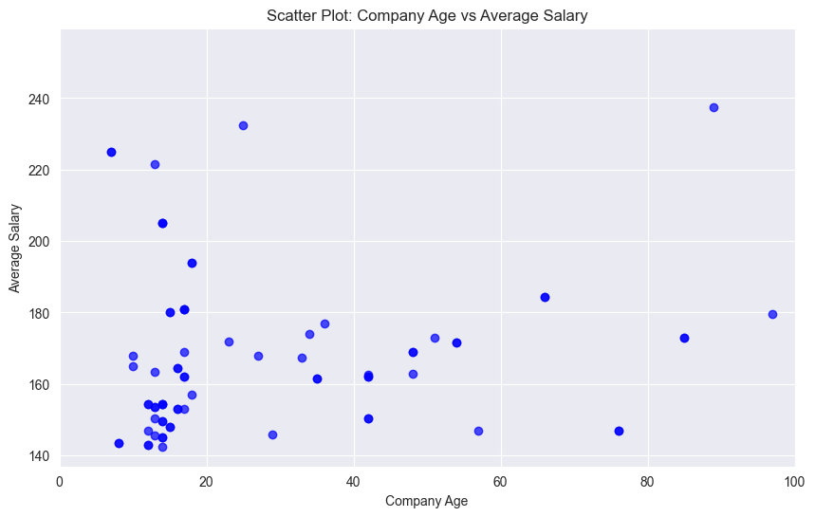

Notes:
Inference 8: The analysis indicates that companies in the field of data science, which pay high salaries, are predominantly those under 20 years of age. Organizations aged between 20 and 60 years offer moderate salary ranges. Notably, there is a discernible trend suggesting that newer companies or startups have a greater propensity to offer higher salaries compared to their older counterparts.

Slide 13
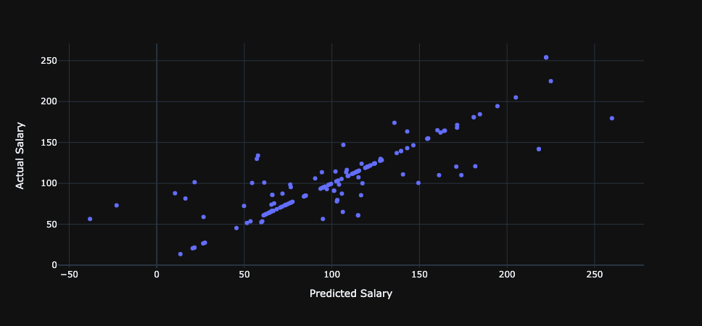

Salary Prediction
Based on Job Description using Machine Learning
Notes:
Prediction of Salary based on the Job Description using Machine Learning Technique
This code aims to create a machine learning model for predicting job salaries based on job descriptions. It uses a pipeline with CountVectorizer for text representation and Linear Regression as the predictive model. The model is trained on this dataset, and after evaluation, it is saved to a file ('LinearRegression.pickle'). The trained model is then used to make predictions on a test set, and finally, it demonstrates the capability to predict the salary for a new job description provided as 'new_job_description'.
Inference: The code model.score(Xtest,ytest) calculates the R-squared (R2) score for the trained model on the provided test data. In this case, the obtained score is 0.6294. The R2 score, ranging from 0 to 1, represents the proportion of the variance in the dependent variable (y_test) that is predictable from the independent variable (X_test). A score of 0.6294 suggests that approximately 62.94% of the variability in the actual job salary values is captured by the model, indicating a moderate level of predictive performance. The scatter plot fig visualizes the relationship between the predicted salaries (ypred) by the model and the actual salaries (ytest). Each point on the plot represents a data instance, comparing the predicted salary on the x-axis to the actual salary on the y-axis. This plot helps assess how well the model's predictions align with the true salary values. A diagonal alignment would indicate accurate predictions, while deviations from the diagonal line suggest discrepancies between predicted and actual values.

Slide 14

Global Analysis

Slide 15
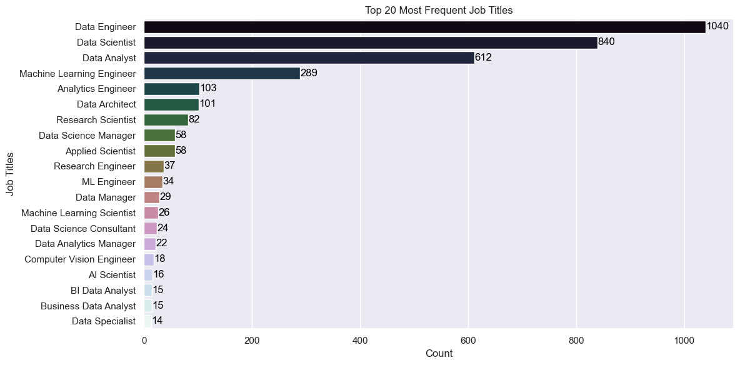
1. What are the Top 10 Job titles globally?
Notes:
Inference 1:Among the 20 most common data jobs globally, data engineering emerges as the predominant role, taking the lead, followed sequentially by data scientist, data analyst, and machine learning engineer. This hierarchy sheds light on the key roles driving the data landscape, emphasizing the critical importance of data engineering in the forefront of contemporary data-centric professions.

Slide 16
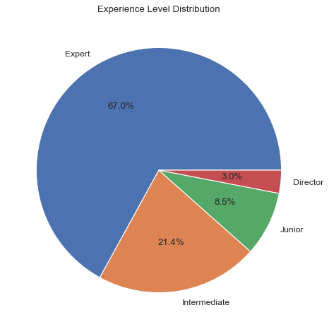
2. What is the experience level distribution?
Notes:
highlights a distinct pattern in experience levels, revealing a prevalence of experts, followed by intermediate professionals and, subsequently, junior roles.

Slide 17
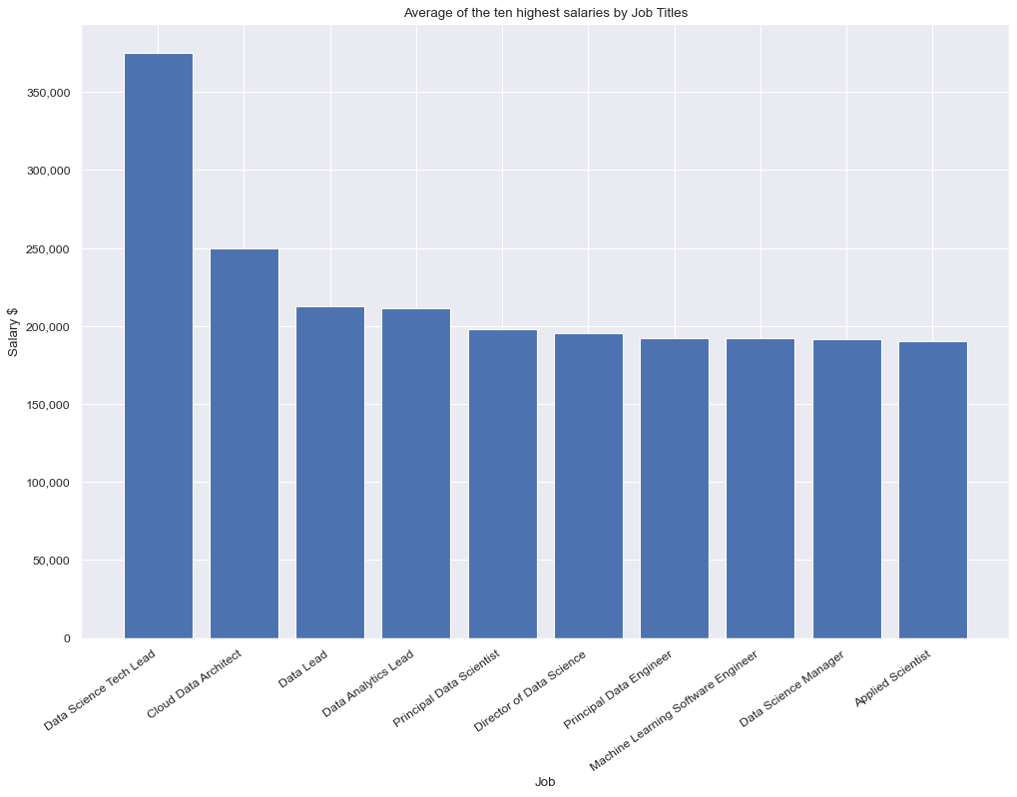
3. Which job titles have the highest salary?
Notes:
Inference 3: The examination clearly indicates that Data Science Lead commands the highest global salaries within the data field, showcasing a substantial earnings gap compared to roles such as Data Analytics Lead, Data Engineer, Machine Learning Engineer, and Data Science Manager, who all earn relatively similar moderate salaries. This insight underscores the distinct salary hierarchies across various key positions in the data domain.

Slide 18

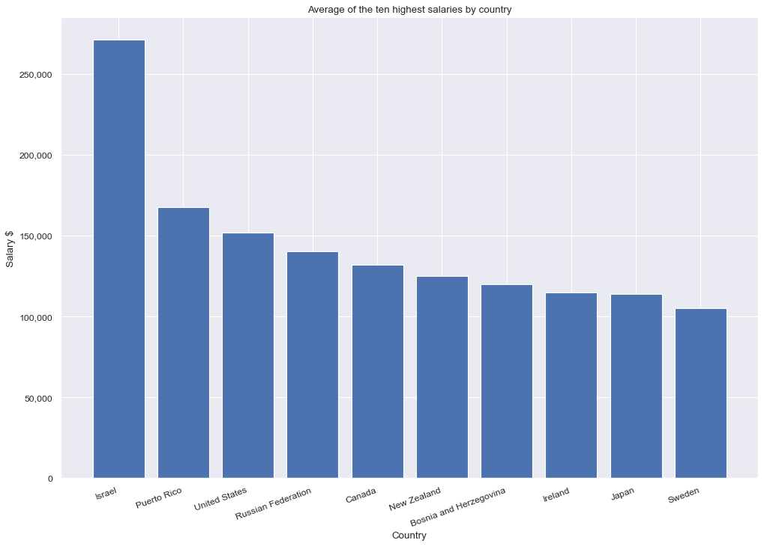
4. Which are the top 10 countries who provide highest salary?
Notes:
Inference 4: The findings suggest that, on a global scale, Israel stands out for offering significantly higher salaries, denominated in USD, compared to other countries. This observation underscores a notable disparity in compensation rates between Israel and the rest of the world.

Slide 19
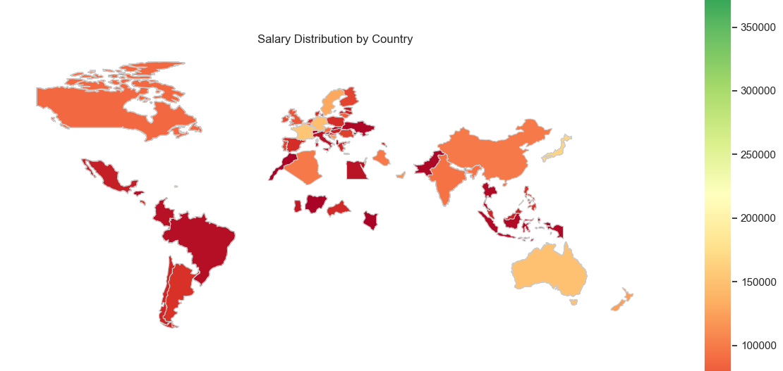

Slide 20
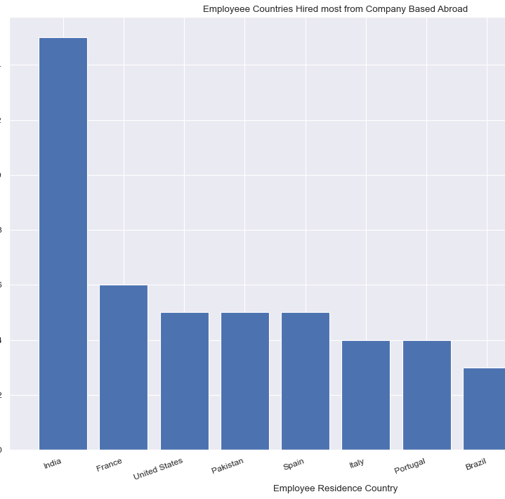
5. Which countries is hired most from company based abroad?
Notes:
Inference 5 Evidently, a substantial majority of Indian employees find employment opportunities with companies based abroad, indicating a significant trend in cross-border hiring. This notable pattern emphasizes the strong global demand for Indian professionals in various sectors.

Slide 21
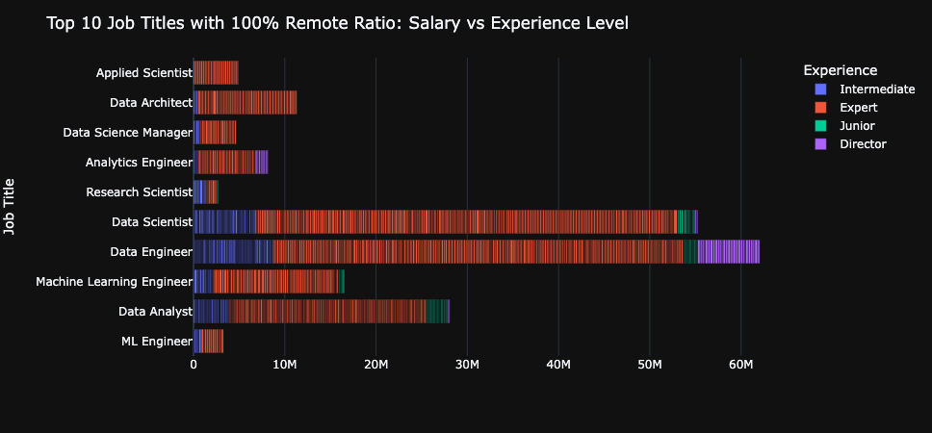
Remote Jobs
6. For remote jobs in data field, how experience level matters?
Notes:
Inference 6:The analysis underscores that remote jobs offering high salaries are primarily secured by experts, with a moderate representation for intermediate professionals. However, the opportunities for junior-level positions in securing such lucrative remote roles appear comparatively limited. This insight highlights a correlation between experience levels and the likelihood of obtaining well-compensated remote positions.

Slide 22
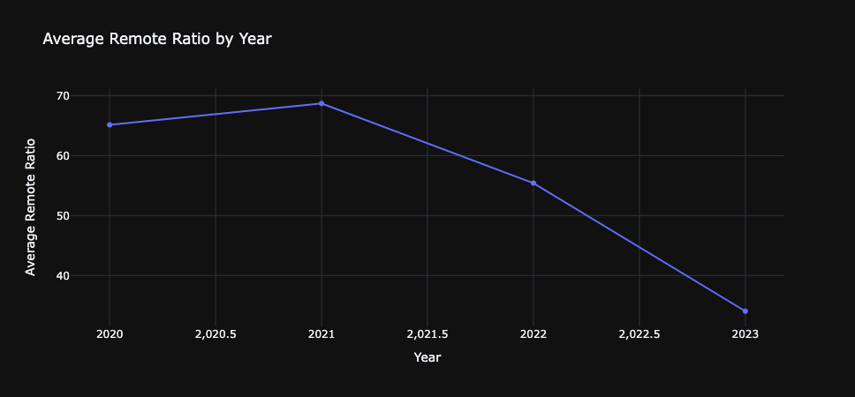
Remote Jobs
7. What is the current trend of remote working?
Notes:
Inference 7 The graph indicates that the peak of remote work occurred in 2021 during the COVID-19 pandemic, but there is now a discernible slowdown in the prevalence of remote jobs. This observation suggests a potential shift in the remote work landscape, reflecting changing workplace dynamics post-pandemic.

Slide 23
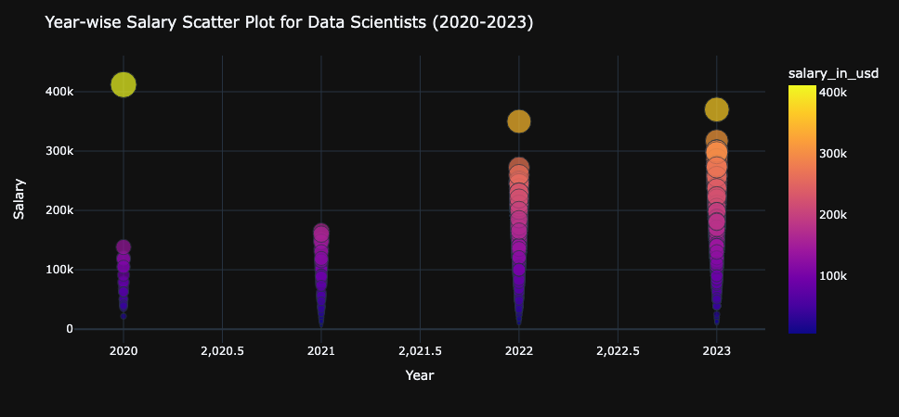
Data Scientist Salary Trend
Notes:
Inference 8 : The scatter plot reveals a consistent upward trajectory in salaries for data scientists from 2020 to 2023, indicating a steady and positive trend in compensation over the years. This observation suggests a favorable market for data science professionals, with increasing recognition and value assigned to their skill set.

Slide 24
Conclusion
Job Demand Disparity:
United States vs. Global: The analysis highlights a notable discrepancy in job demand, with the United States having a higher concentration of data scientist positions, while globally, data engineering roles are in greater demand.
Salary Discrepancy:
Data Scientist Compensation: Despite the global demand for data engineering roles, the salaries for data scientists, both globally and within the United States, surpass those of data engineers, indicating a premium on data science skills.
Remote Job Expertise:
Expertise in Remote Jobs: Examination of available data shows that remote job opportunities predominantly favor experts, with limited prospects for intermediate and junior-level professionals.

Slide 25

Conclusion
4. Global Technology Trends:
Technology Proficiency: While global data on technology skills is lacking, the US perspective implies that Python and Excel are pivotal technologies, substantiating their significance for excelling in the broader field of data.
5. Global Salary Disparities:
Top Salaries Globally: The analysis identifies Israel as having the highest salaries globally, with the United States securing the third position. This sheds light on the variance in compensation structures on a global scale.
6.International Workforce Dynamics:
Indian Workforce Abroad: The data reveals that Indians significantly dominate the workforce for companies based abroad, showcasing a strong international presence and the global demand for Indian talent.
7. Post-Pandemic Remote Work Landscape:
Remote Job Trends Post-COVID: While there is a observed slowdown in remote job opportunities from 2020 to 2023, salaries for data scientists continue to rise. This suggests a promising future for the data science profession, demonstrating resilience and adaptability post the COVID-19 pandemic.

Slide 26
Discussion
Future Work:
1. Enhancement of Salary Prediction Model:
- Refine the model with diverse algorithms and advanced natural language processing for increased accuracy.
2. Global Salary Prediction Model:
- Develop a comprehensive global model, using diverse datasets for calibration across regions, including economies like India and Germany.
3. Cross-Industry Exploration:
- Explore salary predictions in diverse industries for insights into compensation trends, demand dynamics, and skill valuation.
4. International Salary Comparisons:
- Thoroughly examine salary structures in different countries, providing a comprehensive analysis of global economic landscapes and regional variations.
5. Diversification Beyond Data:
- Expand focus to include salary prediction models for various professional sectors, uncovering unique trends and patterns within each industry.

Slide 27

Questions?
If you have any questions or need clarification regarding this analysis report, then please don't hesitate to reach out to me..
Email: arpita.halder@fau.de
Linkedin: https://www.linkedin.com/in/arpitahalder/
GitHub: https://github.com/arpita739

Slide 28
Thank you!

